Slide 1
BOARD Infinity
A Project of Analysing the superstore sales
using Tableau..
For The Course
DATA SCIENCE
Submitted by
Senkottuvelu R

Slide 2
Superstore sale Dataset
Problem:
A superstore often selling household goods, clothes, and electrical goods, as well as food.
As a business manager, try to find out the weak areas where you can work to make more profit.
Source Of Data:
https://www.kaggle.com/itssuru/super-store

Slide 3
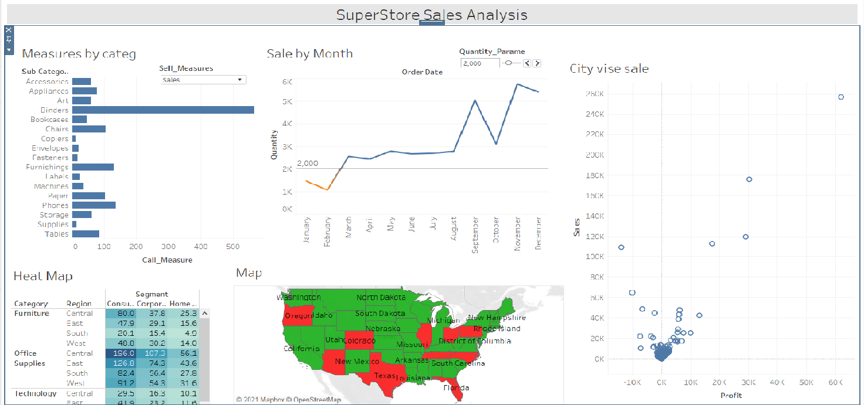
Analysing sale using different charts

Slide 4
Video link for project description..
https://drive.google.com/drive/folders/12i3kyPgOvFLpI1QVJf_NpAOpmoqbre_z?usp=sharing

Slide 5
Conclusion
There is a loss by minimal products like tables, supplies
and bookcases.
Furniture category in central region also a loss
Philadelphia with most profit loss and had high sale
By state vise, the Texas has More loss in profit
Conclusion:
Giving more focus on the product sales to reduce the loss and improve the profit
In Future:
The product such the tables, supplies and bookcases having more sales but high lost, so better to shut the sales and giving focus to the most profitable product is better.

Slide 6
Thanks for giving such opportunity to show my talent.

